Slide 1
Javascript Concepts
if ( bored() === true ) {
bored().stop();
beEnthusiastic();
}

Slide 2
Callback

Slide 3
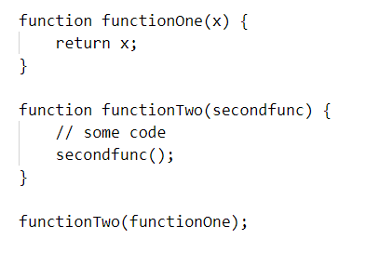
Callback
A callback is a function passed into another function as an argument to be executed later.

Slide 4
Callback - Example
Explanation –
let numbers = [1, 2, 4, 7, 3, 5, 6];
// function returns true if number is odd
function isOddNumber(number) {
return number % 2;
}
// filter() method creates a new array with the elements that pass the test
const oddNumbers = numbers.filter(isOddNumber);
console.log(oddNumbers); // [ 1, 7, 3, 5 ]
// isOddNumber is a callback function. When you pass a callback function into another function, you just pass the reference of the function i.e., the function name without the parentheses ().

Slide 5
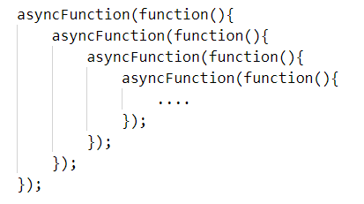
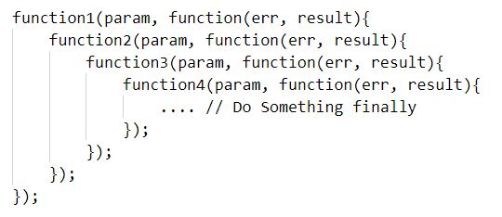
Problem with Callback
Pyramid of doom or Callback hell
Example –

Slide 6
Promise

Slide 7
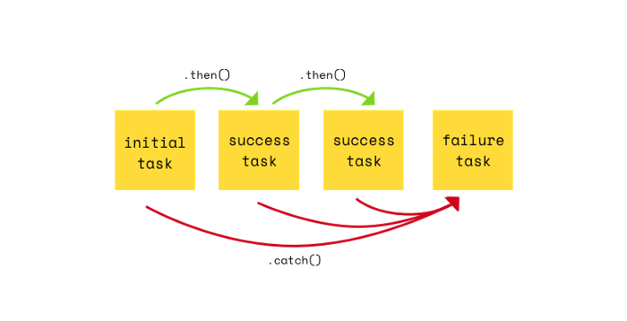
Promise
A promise is an object that may produce a value some time in the future.
A promise is an object which can be returned synchronously from an asynchronous function
How Promise Works –

Slide 8
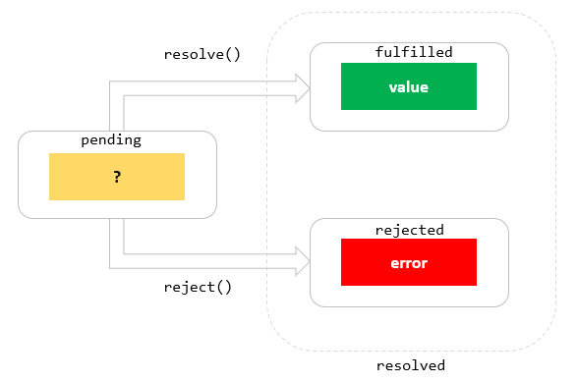
Promise States
Fulfilled: onFulfilled() will be called
(eg: resolve() will be called).
Rejected: onRejected() will be called
(eg: reject() will be called).
Pending: not yet fulfilled or rejected.

Slide 9
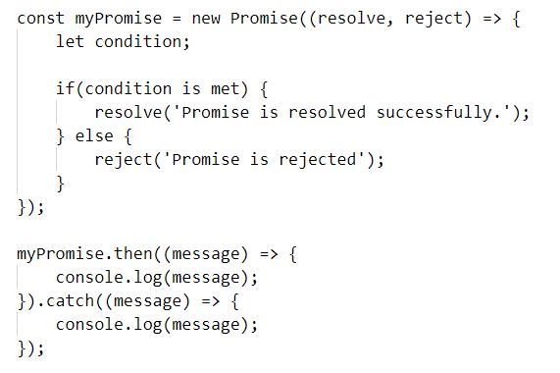
Example -

Slide 10
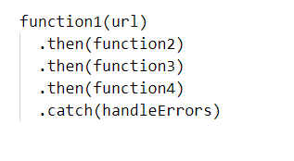
Problem with Promise
Promise Chaining or Promise Hell

Slide 11
Async - Await

Slide 12
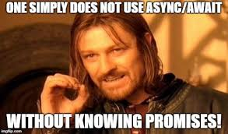
Async - Await
Async - Await makes execution sequential
Async and Await are extensions of promises.

Slide 13
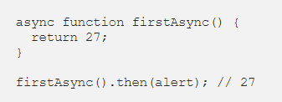
Async - Await
Async -
Async functions enable us to write promise based code as if it were synchronous, but without blocking the execution thread
Using async implies that a promise will be returned.
Code gives the alert output as 27, it means that a promise was returned otherwise the .then() method wont be reached.

Slide 14
Async - Await
Await –
The await operator is used to wait for a Promise.
It can be used inside an Async block only.
The keyword Await makes JavaScript wait until the promise returns a result.
It has to be noted that it only makes the async function block wait and not the whole program execution.

Slide 15
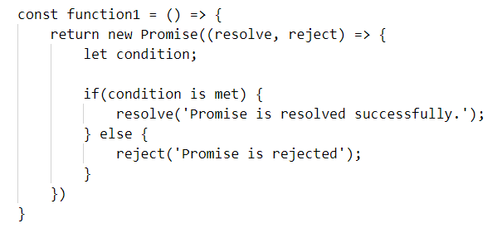
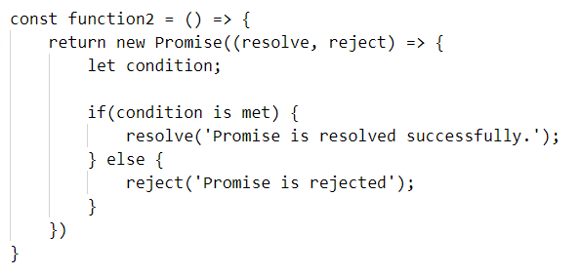
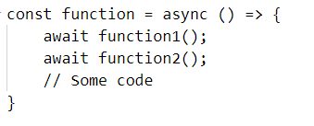
Example

Slide 16
Any Queries ?

Slide 17
Thank you - Shobika Babu

